Slide 1
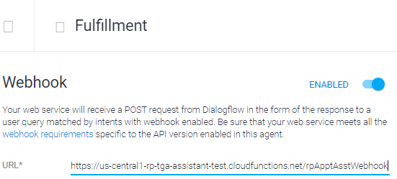

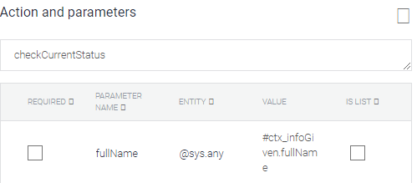
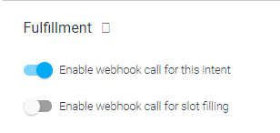
* Ngrok used as a proxy / tunnel only.
It does not affect functionalities
AGENT
WEBHOOK
(e.g Python / Flask App)
Provides a route as entry point
Route
Intent X
If Action = checkCurrentStatus
If Action = othersAction
Intent Y
Extracts parameters
(p1, p2)
Extracts parameters
(p3,p5, p6)
* A few intents may lead to the same action
Do something
Do something
Response Message
(JSON)
Response Message
(JSON)
* Set at individual intent level

Slide 2
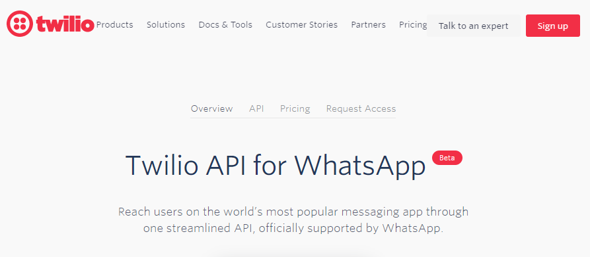
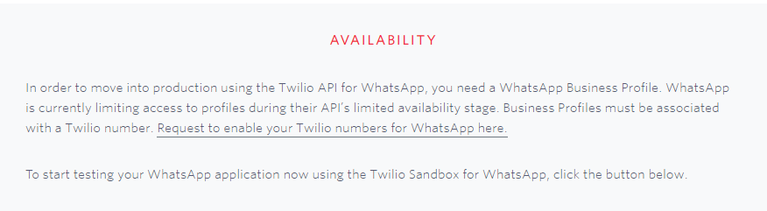
https://www.twilio.com/whatsapp

Slide 3
